Slide 1
Wasatch County Fire District 2011 Calls
Analyzed and Compared to Budgetary Need

Slide 2
Wasatch County Fire District 2011 Run Report Published on the WCFD Website
FIRE CALLOUTS 280
MEDICAL CALLOUTS 91
EXTRICATION NEEDED 25
HAZARDOUS MATERIAL 4
CITIZEN ASSIST/CANCELLED 119
TOTAL CALLOUTS 519
Notes:
Categories are too broad and general misleading the reader

Slide 3
2011 Specific Call Report
Notes:
Specific call breakout based on previous slide

Slide 4
Wasatch County Fire District Callout By Area Published on the WCFD Website

Slide 5
Jordanelle Station 2011 Response

Slide 6
Fire Calls to Stillwater
Of the 123 calls to Stillwater
121 were false alarm fire calls
2 calls were for medical assistance

Slide 7
FYI Alarms @ Stillwater January Through June 2012
Total 55 All False
January and February account for 43 Alarms prior to the design flaw correction in the units
January 33
February 10
March 5
April 1
May 2
June 4

Slide 8
Wasatch County Fire District Budget Calendar Year 2012 For the State Auditors Office
Wasatch County Fire District
Budget
Column #'s
Calendar Year 2010 - 2011 – 2012
For the State Auditors Office
GL Number Account Title Notes:
Budgeted Revenues 815,500.00
31000 Property Taxes 0
31001 Jordanelle Fire Station Bond 5,000.00
32000 Grant Proceeds 0
32001 Jordanelle Fire Station O & M 40,000.00
35000 In Lieu of Fee 110,000.00
36000 Prior Year's Taxes Del 14,000.00
37000 Interest Income 3,500.00
38000 Penalties and Interest 9,000.00
38500 Jordanelle Ambulance Revenue 1,000.00
39000 Miscellaneous Revenues 15,600.00
39650 Cell Tower Flag Pole - Sprint 43,500.00
39700 Shared Employee 53,000.00
39800 Office Lease 62,000.00
39900 Plan & Inspection Revenue 920,000.00
97002 Transfer from Cap Proj Fund 0
97001 Transfer from Enterprise Savings
Transfer To General Fund $2,092,100.00
Total Budgeted Revenues

Slide 9
2012 Budgeted Expenses
Budgeted Expenses
41000 Salaries & Wages 1,026,000.00
41201 Payroll Taxes 80,000.00
41300 Workers Compensation 11,500.00
41500 Employee Benefits 250
42500 Public Notices 600
43000 Travel/Miscellaneous 7,000.00
43500 Audit 21,500.00
44000 Training 12,000.00
46000 Utilities 17,500.00
46501 Phone 5,500.00
50000 Legal Fees 300,500.00
50100 Director Fees 16,000.00
51000 Materials 9,000.00
51500 State Retirement 175,000.00
52000 Office Supplies 9,000.00
53000 Professional Services 6,000.00
54000 Liability Insurance 17,000.00
54500 Health Insurance 222,000.00
54550 Hazardous Materials Handling 7,500.00
55000 Equipment & Supplies 55,000.00
55100 Equipment - Repairs & Maintenance 80,000.00
55150 Jordanelle Ambulance Expense 7,000.00
55200 Clothing - Uniforms 2,450.00
56000 Mutual Aid 2,500.00
57000 Smoke Detectors 500
60001 Depreciation Expense 0
61001 Bad Debts 0
70001 Jordanelle Fire Station Interest 0
23401 JFS Lease/Building Payment 0
23501 JFS Lease/JE2 Engine Payment 0
71000 Capitol Outlay 0
90000 Miscellaneous Expense 0
14200 PTIF Investment savings 0
98001 Transfer to General Fund 0
98002 Transfer to Capital Proj Fund 0
Transfer Out to Enterprise Fund $0.00
Total Budgeted Expenses $2,092,100.00

Slide 10
2012 Proposed Fire Budget
$815,500 2012 Proposed Tax to all Residents of Wasatch County For Fire Service in the Heber Valley
$566,150 2011 Heber Valley Budget for Fire Service
$249,350 Over taxed for Fire Service

Slide 11
Fire Service Countywide Costs from annual property tax assessment
Fire Budget 2012 $2,092,100
Taxable Properties in Wasatch County 22,500
Cost Per Property $93 (Across the Board)
Example
Millage 0.000228 X $300,000 Property = $68.40

Slide 12
Cost Per Property Value for Fire Service from annual property tax assessment
$10,000,000 X 0.000228 = $2,280 Taxable Amount
$5,000,000 X 0.000228 = $1,140
$1,000,000 X 0.000228 = $ 228
$750,000 X 0.000228 = $ 171
$500,000 X 0.000228 = $ 114
$407,900 X 0.000228 = $ 93 Break Even Point
$300,000 X 0.000228 = $ 68 Taxable Amount
$200,000 X 0.000228 = $ 45
$100,000 X 0.000228 = $ 22
$50,000 X 0.000228 = $ 11

Slide 13
2011 Fire District Cost Per Call For Property Owners of Heber Valley -vs- Jordanelle
Heber Valley Property Owners
$566,150 – 32% paid by Jordanelle for Fire Service in the Heber Valley =$181,168
$566,150 - $181,168 = $384,982 / 227 calls = $1,696 per call
Jordanelle Property Owners
$2,149,173 + 32% ($181,168) paid to General Fire Budget = $2,330,341
$2,330,341 /292 = $7,980 per call

Slide 14
2011 Fire Fighter Response Per Area
There are more fire fighters and equipment responding to calls for service in the Heber Valley than are responding to the Jordanelle
Station Responding & Code | Average # Of Apparatus Responding | Average # Of Personnel Responding | # Of Calls For Each Station
Charleston (1) | 3.86 | 18.43 | 7
Soldier Creek (16) | 4.5 | 16.5 | 2
Woodland (20) | 4 | 15 | 2
Girl Scout Camp (19) | 4 | 14 | 1
Wallsburg (5) | 2.63 | 11.69 | 11
Timberlakes (13) | 3.27 | 11.09 | 16
Midway (3) | 3.14 | 9.67 | 57
Wasatch County (8) | 2.36 | 9.29 | 14
Heber (7) | 2.27 | 8.78 | 111
Strawberry1 (15) | 1.67 | 3 | 6
Strawberry2 (18) | 1 | 3 | 1
Jordanelle (9) | 1.01 | 2.69 | 291

Slide 15
Inadequate Fire Staffing at the Jordanelle Fire Station
The Full Time Fire Station at the Jordanelle is not adequately staffed to properly fight a fire, especially a structure fire, were it to occur in the Jordanelle area.
They have to wait for other fire fighters to arrive from the Heber Valley to meet fire fighting standards.
Chief Ernie Giles

Slide 16
2004 -vs- 2012 Outside Legal Service Budget
2004 $ 750
$0 was spent on legal fees
2011 $386,000
Entirely spent on legal fees
2012 $300,500
Tentative Budgeted (Not Approved Yet)
Being spent rapidly each month
2013
Tentative Budgeted $300,500

Slide 17
Laws Governing Assessment Areas
November 2011 Jordanelle Owners successfully protested the Jordanelle Assessment Area.
This eliminated the Jordanelle Special Service Fire District
BUT
The Wasatch County Special Service Fire District STILL exists even though the 2012 legislature removed Special Service Districts for Police, FIRE, Paramedic and Ambulance Service

Slide 18
Title 17B-1-302 UCA Who can be on the Board of Trustees for a Special Service District
17B-1-302. Board member qualifications -- Number of board members.
(1) (a) Each member of a local district board of trustees shall be:
(i) a registered voter at the location of the member's residence; and
(ii) except as provided in Subsections (1)(b) and (c), a resident within:
(A) the boundaries of the local district; and
(B) if applicable, the boundaries of the division of the local district from which the member is elected.

Slide 19
Title 17B-1-308 UCA Councilmen can not receive payment for being on the Fire District Board (or any other board)
17B-1-308. Boards of trustees comprised of county or municipal legislative body members.
(1) If a county or municipal legislative body by statute also serves as the board of trustees of a local district:
(a) the board of trustees shall hold district meetings and keep district minutes, accounts, and other records separate from those of the county or municipality;
(b) subject to Subsection (2), the board of trustees may use, respectively, existing county or municipal facilities and personnel for district purposes;
(c) notwithstanding Subsections 17B-1-303(1) and (2), the term of office of each board of trustees member coincides with the member's term as a county or municipal legislative body member;
(d) each board of trustees member represents the district at large; and
(e) board members may not receive compensation for their service as board members in addition to compensation they receive as members of a county or municipal legislative body.

Slide 20
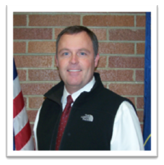
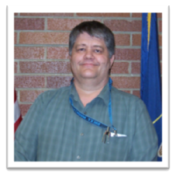
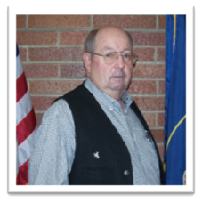
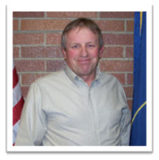
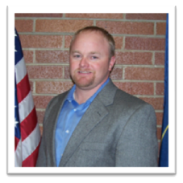
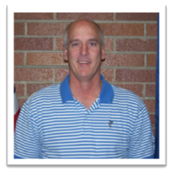
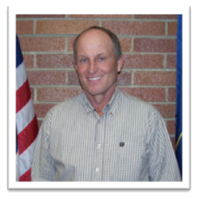
Fire District Board Payments In 2011
STEVE FARRELL Fire Board Member $4,800
MIKE KOHLER Fire Board Member $4,800
KIP BANGERTER Fire Board Member $4,800
KENDALL CRITTENDEN Fire Board Member $4,800
JAY PRICE Fire Board Member $4,800
GREG MCPHIE Fire Board Member $4,800
STEPHEN CAPSON Fire Board Member $4,800

Slide 21
Fire District Board Payments In 2012
STEVE FARRELL Fire Board Member $2,400
MIKE KOHLER Fire Board Member $2,400
KIP BANGERTER Fire Board Member $2,400
KENDALL CRITTENDEN Fire Board Member $2,400
JAY PRICE Fire Board Member $2,400
GREG MCPHIE Fire Board Member $2,400
STEPHEN CAPSON Fire Board Member $2,400

Slide 22
35 Special Service Districts Established for Wasatch County Plus Other Boards Paying County Council Members & Municipal Officials
Appears to be in violation of Utah Codes
17B-1-302 Who can be on the board of trustees of a special service district
17B-1-308 Board members may not receive compensation for their service as board members

Slide 23
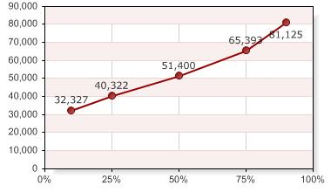
Fire Chief Salary Nationwide
Chief Giles Salary
$92,380
Similar Sized Fire Departments Nationwide
Average = $52,129
Number Reporting: 45

Slide 24
Fire Chief Salary Is:
$40, 251 or 44% higher than the average for Fire Chiefs with similar fire departments and demographics in the United States
$92,380 appears to be the highest paid salary for Fire Chiefs with similar fire departments and demographics in the United States

Slide 25
December 27, 2012 PUBLIC HEARING for Raising Taxes for Fire Service
Many questions need to be asked concerning the actual cost of fire service in Wasatch County.
Questionable statistical activity from 2011compared to what is being published by the Fire District
Excessive budgets containing excessive line items
Line item payments to the Fire District’s Board of Directors that don’t appear to be allowed by state law.
A Fire Chief that appears to be the highest paid in the United States for similar sized fire departments

Slide 26
How Much Should You REALLY Be Paying For Fire Service In Wasatch County
?

